Slide 1
FACTORY IT SYSTEMS STANDARDIZATION
CONTENTS
1
Organization Chart (New assignment)
Slide 01
2
Achievement
Slide 02
3
Approach & Factory IT Systems Issue
Slide 03-04
4
Analyses & Improvement
Slide 05-08
5
Development Plan & Vision
Slide 09-10
Presented by : Nguyen Van Chung
Join Date : 25-Apr-2011 (~9 years)
Current Position : Assistant Manager
New Position : Manager
Section : Information Systems Group
Notes:
(0.5m)
Good afternoon everyone, I am Chung , from ISG. Today, I’m delighted to be here to tell you about my promotion report .
My topic is “Factory IT SYTEMS STANDARDIZATION”.
My presentation is divided into 5 parts.
Let’s me start with part 1: Organization Chart (New assignment)

Slide 2

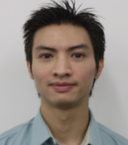
1. Organization Chart(New Assignment)
01/10
Information Systems Group
My Responsibilities
GM Teramoto
Leading ISG to achieve KPI policy
Standardize existed procedure
Accelerate communication with
Panasonic group & oversea companies
to apply more IoT for company
Centralize all relevant systems
Level up more all Dept. IT skill
Toward Smart Automation Factory
Challenge as Manager from Apr 2019
M(Chung)
SAP
Management
AM
AM(Chung)
Sup
Sup
Sup
2
2
3
Officer
Infra
ISM
Develop
Notes:
(0.5m)
Well, now I’m a AM of Management team.
In current position, I’m working as Manager
I’m leading ISG to achieve KPI policy, Standardize existed procedure , Accelerate communication with Panasonic group & oversea companies to apply more IoT for company.
After become manager, I will Centralize all relevant systems, Level up more all Dept. IT skill
And Toward Smart Automation Factory

Slide 3

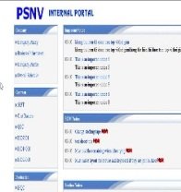




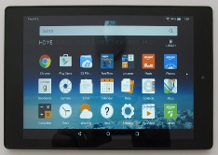

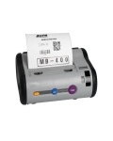
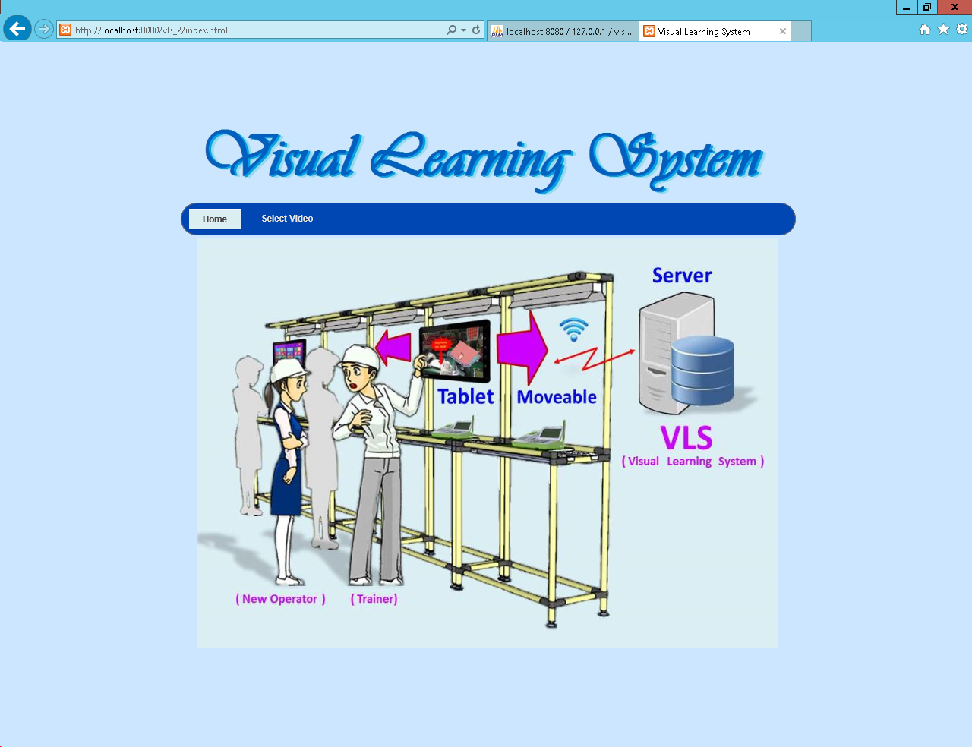
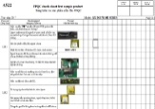




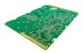




2. Achievement
02/10
Summary Achievement & Main IT Technology Development History
FY2011
FY2012
FY2013
FY2014
FY2015
FY2016
FY2017
FY2018
FY2019
MS Office
SQL SERVER
Portal
Print label
Handy Terminal
Smart Reader
Windows Tablet
Android Tablet
OCR
Mobile
Printer
ISO
Part No :
A
Part card:
A
QTY:
30
Scan
Assembly
Inspection
Packing
Android
scanner
Critical Systems Deployment
Item | System Name | Section | Period | Save Cost (K$)
1 | Skip Process Control System | FA-Production | 09/2019-01/2020 | △ 13,2
2 | Collecting Data System | Production | 11/2019-02/2020 | △ 27.0
3 | Traceability System | Production | 11/2019-03/2020 | △ 66.0
Notes:
(1m)
Next I would like to summary achievement and main IT Technology Development
At first, we are helpdesk but after we develop many systems for factory by new devices & technology year by year.
This year we developed 20 systems total save cost more than : 220K$.
In there, 3 critical systems:
Skip Process Control
Collecting Data System
Traceability System

Slide 4
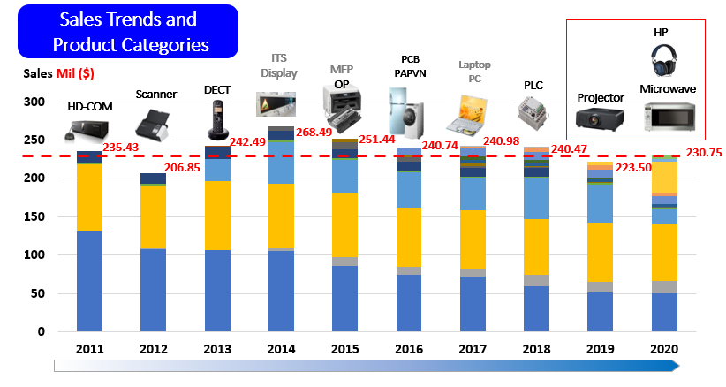
3. Approach
03/10
PSNV Situation
Problem:
Sales amount is not increase
Some product are discontinued & reduce
To Get more Profit for PSNV
Company Policy:
Produce more new products
Develop current business into automation
Realize Smart Factory by automation AI/IOT & reduce fix costs
To achieve Company Policy:
All IT Systems need to apply for new product on schedule.
Deeply analyze current process to develop better systems
Study more new technology to deploy more intelligent systems
Notes:
(0.5m)
Next I will say about current PSNV Situation
Our sale amount is not increase => to get more profit, company direction :
Produce more new products
Develop current business into automation
Realize Smart Factory by automation AI/IOT & reduce fix costs
So from IT view point, to achieve company policy.
All IT Systems need to apply for new product on schedule.
Deeply analyze current process to develop better systems
Study more new technology to deploy more intelligent systems

Slide 5
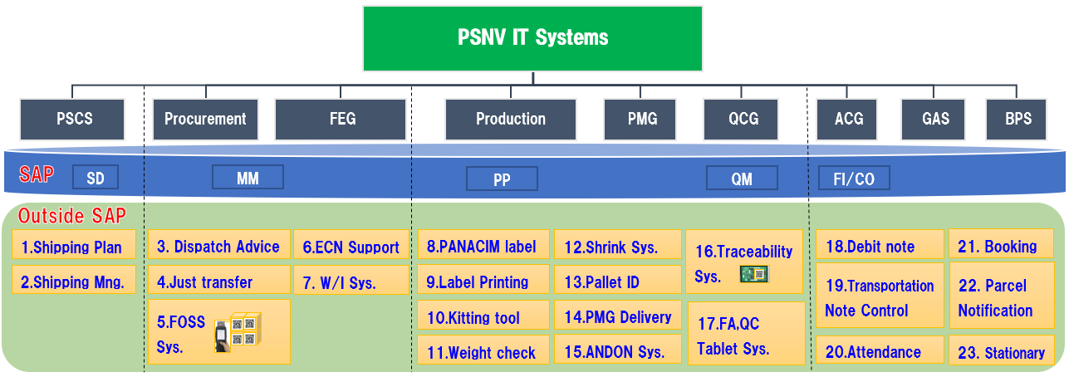



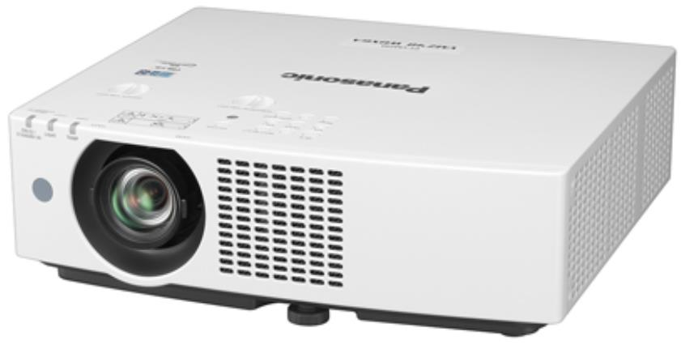
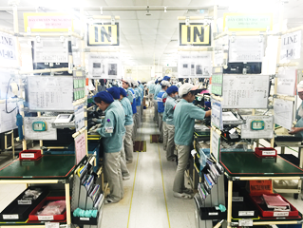
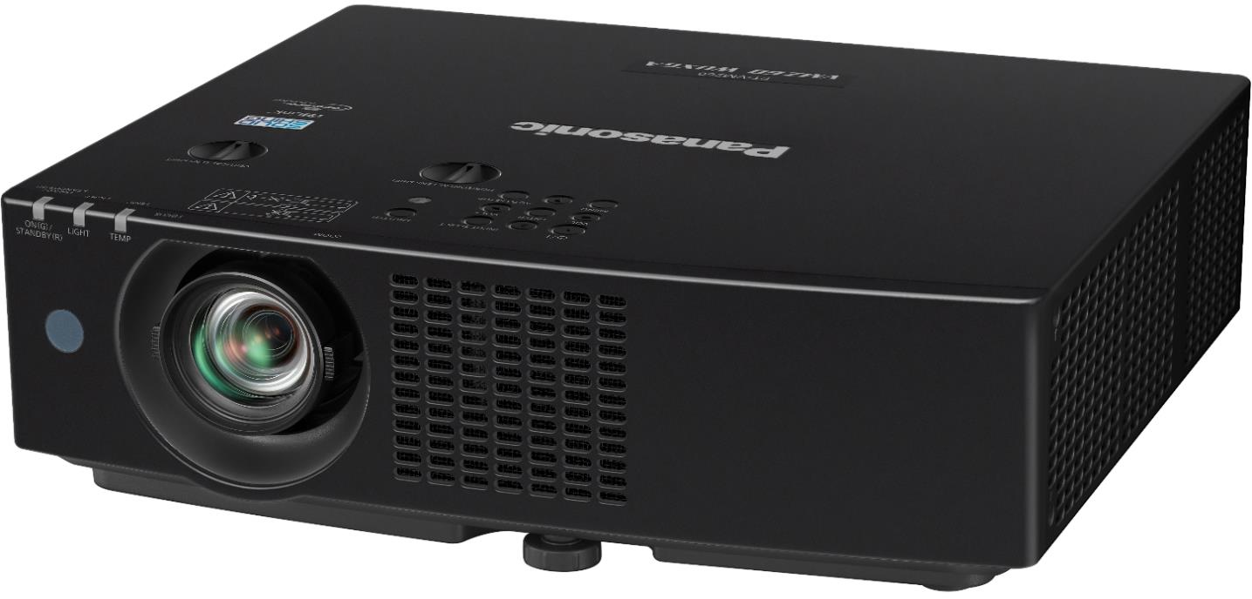
3. Factory IT Systems Issue Overview
04/10
IT Systems are not ready when new model/category increasing requisition
Quality Issue is still happening frequently in the factory
SD: Sales and Distribution
QM: Quality Management
MM: Materials Management
FI/CO: Financial Accounting/Controlling
PP: Production Planning
Issue①
[D]Systems Deployment Lead time (Week)
Issue②
New Request
Issue③
[Q.C]Can’t find exact linkage data
Problem:
Projector (Chinese) IT systems can not apply for PSNV
Critical
Market
Request
20 HC
Impact to
PSNV Business
5 days
6 Dept.
Notes:
(1.5m)
Yes, We IT have many systems and we must apply all systems following PSNV business .
In This FY, we have some new model , new product and market request.
When we try to deploy all systems on schedule, we face on some issues.
The 1st issue for new model , I calculate system deployment lead time of each system, then FA systems we need to take long time because FA has many steps and need to deploy 1 by 1
The 2nd issue for new product, Projector IT, the chinese systems cannot apply for PSNV. We need to make all system by our self.
The 3rd issue for market request to provide production history data but we cannot provide exactly linkage data
(Sometime when market claim, we have ever taken many man-power to find data but not correct 100%) =>
That is just for 1 product. You can image if some product market request at the same time => How do we do. => That will be impacted to PSNV business.
I have just told you 3 issues. Next let me explain more detail of each issue.

Slide 6



4. Analysis & Improvement
05/10
Issue

FA Process takes 16W to develop because has many checker file format.
Weight Check cannot detect previous steps.
There is Risk for Skip Process(2 happened in FY2019)
Current FA Process: Inspection checker result is NG but product still pass to next step
Case 1: (8W)
Automation
Line
NG
OK
NG
OK
OK
Assembly
Checker 1
<JP>
Checker N
<JP>
Shipping Setup
Weight check
Pallet ID
Case 2: (8W)
Normal Line
OK
NG
OK
OK
Assembly
Checker 1
<JP>
Checker N
<JP>
Weight check
Pallet ID
Solution: Standardization total FA Process & develop Skip Process Control Systems (01/2020)
I make a standard of checker output file and cooperate PE to negotiate JP change it for all category
OK
NG
NG
Assembly
Checker 1
<JP>
Checker N
<JP>
Skip Process Control
Weight check
Pallet ID
OK
OK
OK
OK
OK
Link
Simple & Effective
Ready for Spread
New Function
Apply DP,PBX
604 Model
Collecting CSV file with keys:
Checker ID, Product ID (Model, Serial) and Result (OK/NG)
Result: △75% Reduction IT deployment lead time for FA Save: 13.2K$
Notes:
(1.5m)
About Issue 1, FA process takes 16W to develop because has many checker file format (some text file, some. Csv file depend on product specification)
Current FA Process:
In PSNV there are 2 kind of systems for automation line and normal line .
If we develop 1 by 1 we need to take 8 weeks/ systems.
Solution we analyze deeply and combine 2 systems to 1 system to reduce time.
On the other hand, during analyze the solution we find some problem in overall FA process.
Inspection checker result is NG but product still pass to next step because each checker has independent program.
So I standardize all FA flow again and add more new function and linkage with all next steps.
After develop skip process control we save 75% to make system for FA and Save more than 13K$

Slide 7

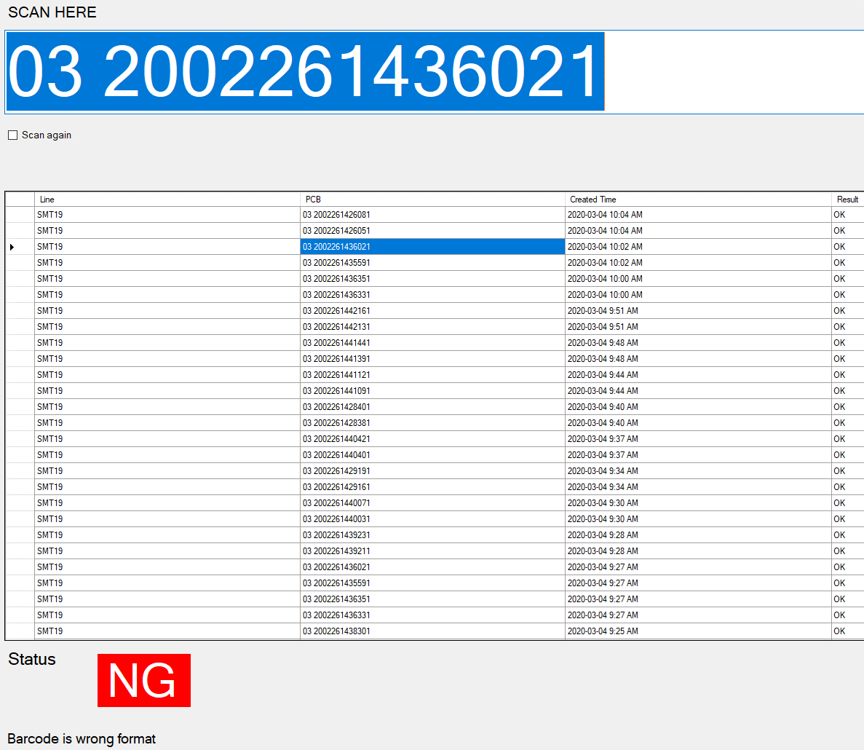
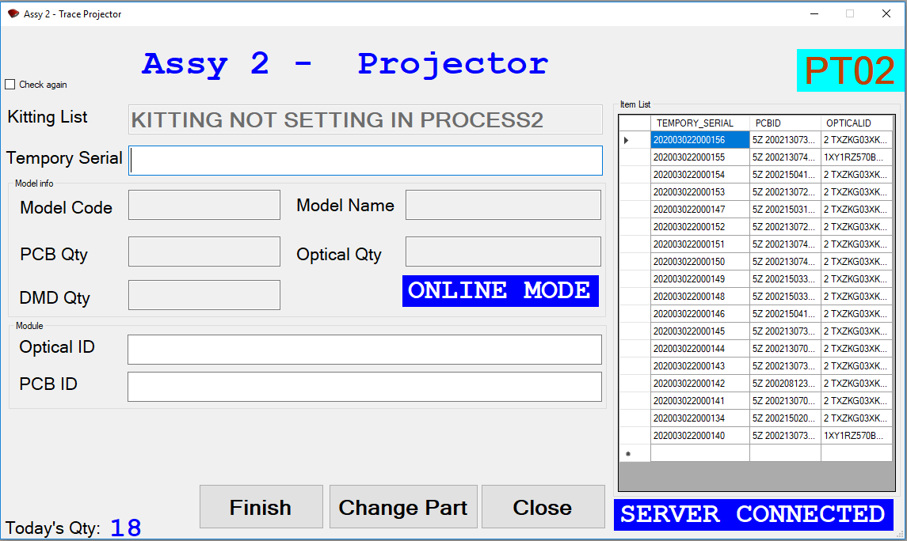
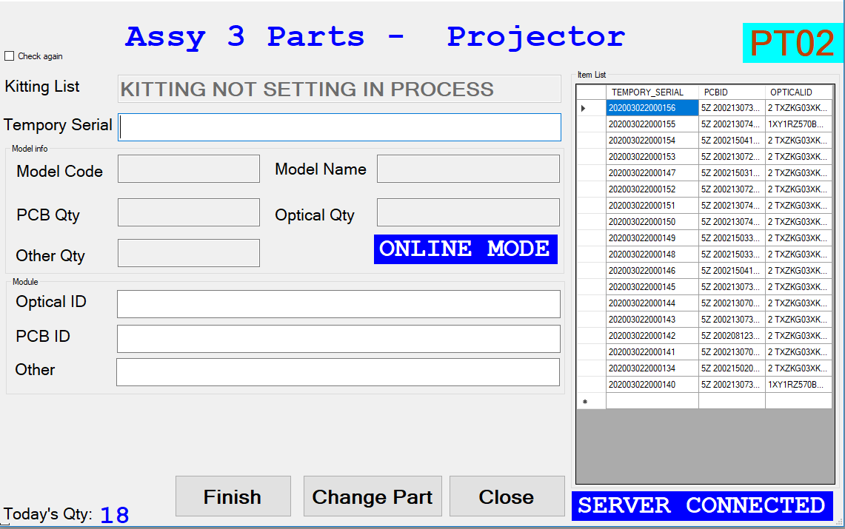

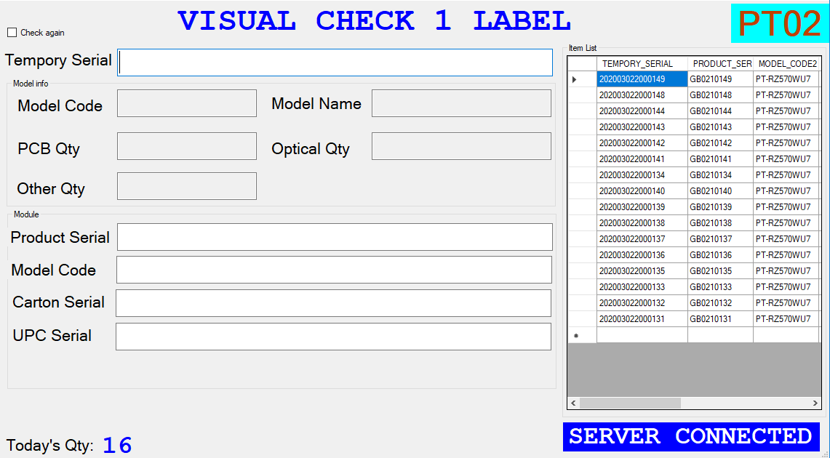
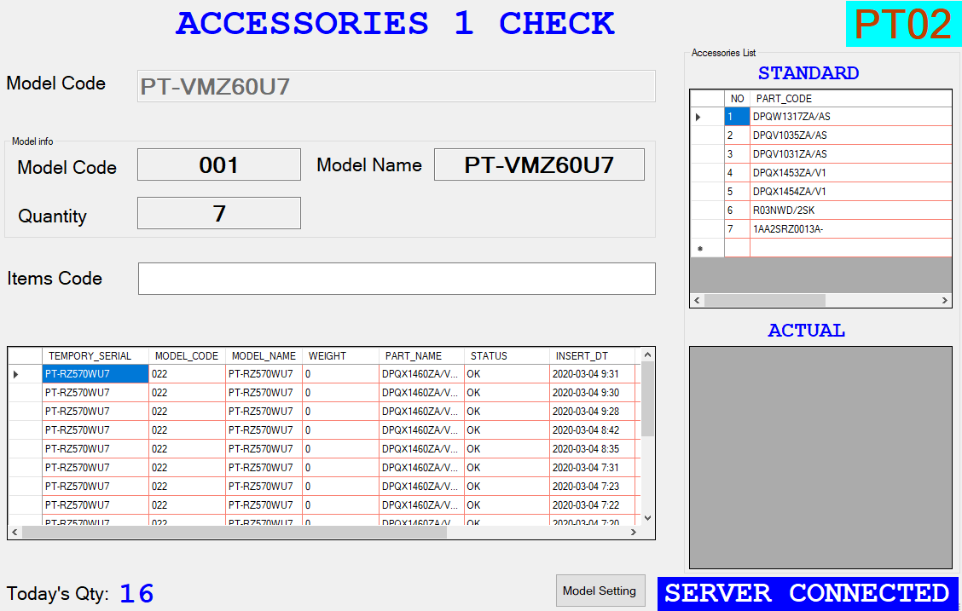
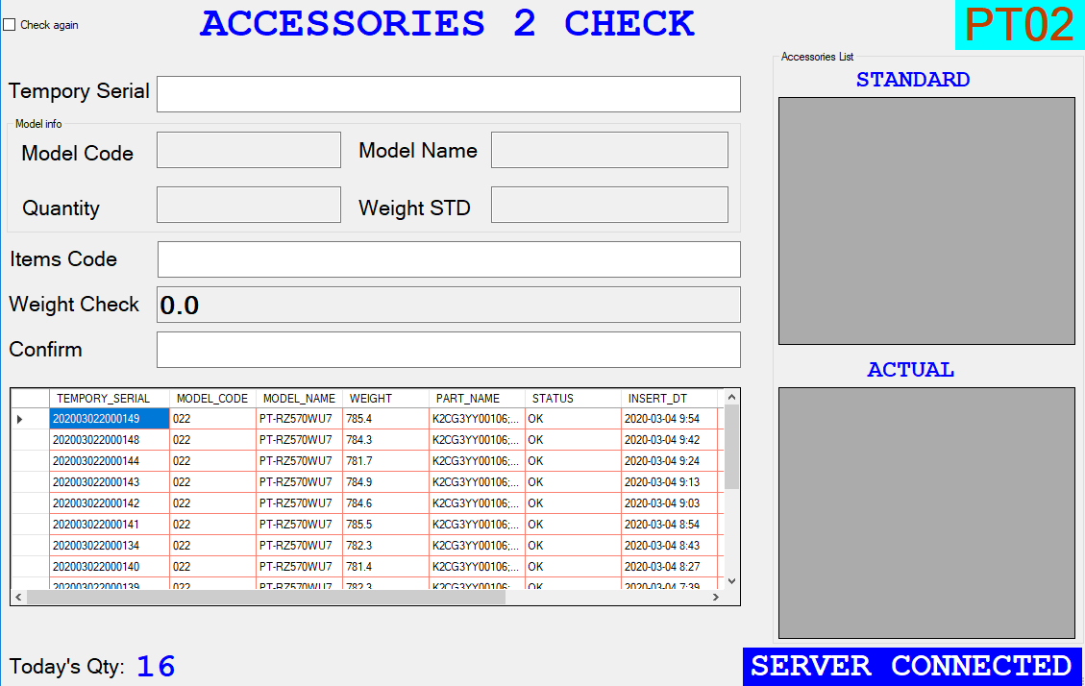
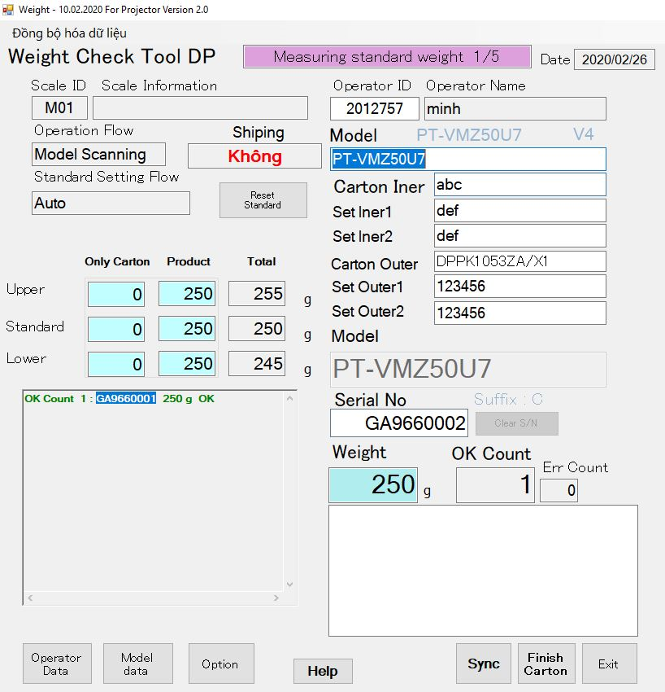
4. Analysis & Improvement
7/10
06/10
Issue

Projector product control manually because different with all our process
PCG used outsourcing software, just suggest function oriented system
Current Situation
Solution
If any process, not control by IT sys.
Manual Checking & Recording
Skip Process difficult to detect
Total Productivity is decrease
Study about actual process in PCG
Make standard system workflow for projector product
Optimize System follow current PSNV requirement
Standardize System Flow for Projector & Develop Collecting data System (02/2020)
Process | MCS | SMT | ASSY1 (PCB) | ASSY2 (Optical, PCB) | ASSY3 (Model, Optical)
System (Operation)
FOSS
PanaCIM
Process | FCT | Visual check | Accessories1 | Accessories2 | Weight Check
System (Operation)
Verify Function
Result: Running for all Projector Model Save: 27.0K$
Notes:
(1m)
Next shall we move to Issue 2:
Projector product control manually because different with all our process, so we need to manual checking & recording.
Solution : I study actual process in PCG.
During develop system time, I have to negotiate many time with PCG and concerned sections to finalize the solution.
Then deeply analyze each step to make standard workflow and optimize system follow current PSNV requirement.
Finally I’m leading project to develop Collecting data system for all process
From MCS to SMT, and all FA Process (10 steps).
Now we completed system and running all projector model. We saved 27K$

Slide 8
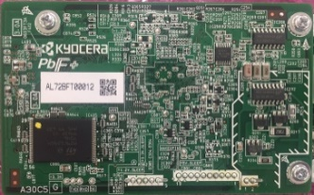



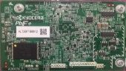






4. Analysis & Improvement
07/10
Issue
③
Many Supplier still not provide Material Lot#
Cannot trace Material Lot# from Model and Serial No. exactly
Market required trace back all history data
Current Situation
Solution
Material Lot#. is not enough/no barcode
Co-operate with Procurement to negotiate supplier
following our standard label, scan character if no barcode
Our Process Traceability base on
Production Time only(Time in, Time out)
Applying Trace ID barcode to link all process to
identify exactly Material Lot#
Standardize Traceability System (03/2020)
MCS
SMT
DIP
FA
Pre-Shipping
PCB Barcode
Reading
PCB ID
Reading
PCB ID
Reading PCB ID,
Model, S/No, Pallet ID
Reading
Pallet ID
New Function
Reading
Material Lot#
TraceID
TraceID
TraceID
TraceID
Scan
Traceability Server
Check
Result: Deploy Traceability System for Projector Save: 66.0K$
Notes:
(1.5m)
Next, let me move to Isssue 3:
Material Lot#. is not enough/no barcode
Currently when market request to trace back history production data, we need to extract data from each process to excel file, then base on production time we try to find the linkage of each process. => Do that some mat.lot will be mixed together.
Solution:
We negotiate with about 200 supplier (domestic and oversea) to let them following our standard label.
And we apply Trace ID barcode (the unique key to link all process to identify exactly Mat. Lot#)
All process I standardize Traceability System by Develop new function of each steps
From MCS, if no barcode MCS will issue barcode material then read Mat. Lot;
Next steps, before produce product we issue Trace ID barcode and all steps will scan TraceID barcode and mandatory info.
Finally all data linked together and keep on server. We can track back exactly data
Deploy this system, we save 66K$

Slide 9


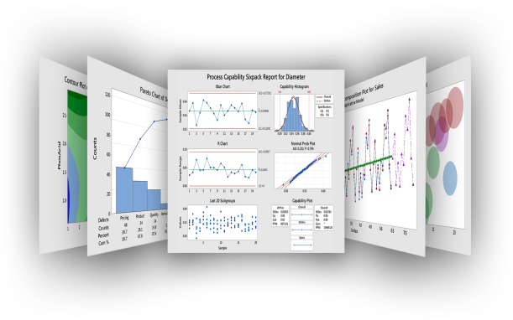




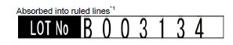
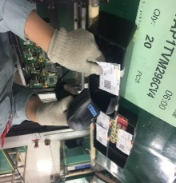
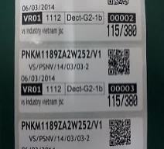

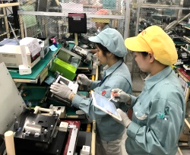
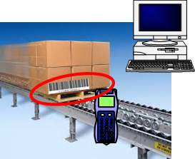
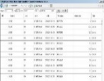

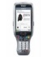
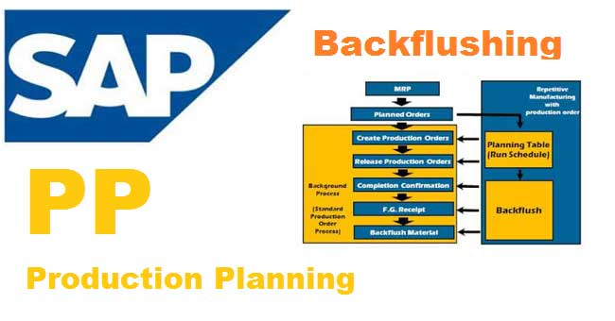
5. Continuous Improvement
08/10
Pro.①
[Q.C.D] Total Improve IT Automation Skills for all Dept. by Open VBA Training Course.
ACTION
TARGET
FY2020 : 2 People/ Dept.
△50% Manual Jobs in Excel
Pro.②
[Q.C.D]Strengthen ROH–HALB–FERT Control By Develop Auto Backflush All Process
・MCS
・PQC
・SMT
・DIP
・PMG
・FA
・OQC
・PSCS
SAP
A2
A1
Sys
B2
B1
ECN change
Part A -> B
Part No :
A
Part card:
A
DB
DB
SAP
DB
QTY:
30
C2
C1
Date
Plant
Cat
Please check carefully
FOSS
Inspection Check
Reel and PCB
Part card
PMG mat. trans
Serial Mng.
Tablet sys
E-Tally
Direct section | MCS | SMT | QC | PMG | FA | PSCS
No. of SAP Account | 34 | 21 | 26 | 11 | 19 | 48
Total | 170 Accounts
ACTION
TARGET
Expect: △ 34 Accounts
(△20% Total SAP Account)
Notes:
(0.5) To continuous improvement in next FY.
I will do 2 project.
I will open VB Training Course for all Dept. => Target Reduce 50% manual jobs in Excel
Strengthen factory streamline by develop Auto Backflush all process => Target redue: 20% SAP Accounts

Slide 10
品質概況と取組
5. Development Plan
09/10
Seri No. | Item | Activity | FY2019 |  | FY2020 |  |  |  | Plan Target
 |  |  | 3Q | 4Q | 1Q | 2Q | 3Q | 4Q
 | System Deployment Lead time | Skip Process Control System |  |  |  |  |  |  | 01/2020 100% Completed △75% Develop time
 | New Request | Collecting Data System for Projector |  |  |  |  |  |  | 02/2020 100% Completed
 | No Linkage data for all Factory processes | Traceability System For Projector |  |  |  |  |  |  | Completed 90% 03/2020 Ready Spread
 | Improve IT Skill for all Dept. | Open VBA Macro Training class |  |  |  |  |  |  | FY2020
 | Factory Streamline by Auto Backflush | Study & develop Auto Backflush system for all processes |  |  |  |  |  |  | FY2020-FY2021
Iss.①
3 Automation lines
Normal line
Apply DP,PBX
604 Model
Iss.②
Projector
Go-live
Iss.③
Projector
Microwave
Other
Pro.①
2
2
2
2
Pro.②
Study & Deploy prototype
◇ Top ISG Mission : No Manpower, No Paper, No Manual Job by IT Automation Systems
Notes:
(0.5m)
Finally let me show you about Development Plan

Slide 11
品質概況と取組
5. Vision (Future Plan)
10/10
❐ Target: 1 staff Grade-up
MY GROUP
No. | Activity | Schedule FY2020-FY2021
 |  | Apr | May | Jun | Jul | Aug | Sep | Oct | Nov | Dec | Jan | Feb | Mar
1 | Teamwork building
2 | Soft skills training
3 | Level up 1 member
4 | ISG Kaizen & QCC
5 | Multi skill up
1st
2nd
1st
2nd
Sup to AM
Kaizen
QCC
Sharing experience, study new technologies (5G,AI,Beacon,IoT,SAP Hana...)
More Profit by ISG Systems
COMPANY
Seri. No. | Activity | 2020 | 2021 | 2022 | 2023 | 2024 | Plan Target
 | “More Made In Vietnam” by ISG Systems Build R&D Team & Standardize 1 business system to sale in Panasonic Group |  |  |  |  |  | FY2022 1 system
 | Cooperate R&D Center to Build Automation Systems & Smart Factory Apply AI to Diagnose & correct system problem. |  |  |  |  |  | FY2023 1 Line auto from SMT to FA
 | Establishment of IT Consultant Center Increasing sale IT products & provide more service & IT Solution to other companies. |  |  |  |  |  | FY2024
Standard
Vis.①
Sale
Vis.②
Study
Vis.③
Transformer
◇ Top ISG Strategy : “More Made In Vietnam” by IT Automation Systems
Notes:
(1m)
The last one I would like to tell you about my vision

Slide 12
Let PSNV Become Smart Factory No.1
Always Set High View Point To Find The Best Ways To Company Success
Thank You !
Notes:
My slogan is …
Thank you for your listening.

